Slide 1
Chapter 4 Informed/Heuristic Search

Slide 2
Outline
Limitations of uninformed search methods
Informed (or heuristic) search uses problem-specific heuristics to improve efficiency
Best-first
A*
RBFS
SMA*
Techniques for generating heuristics
Can provide significant speed-ups in practice
e.g., on 8-puzzle
But can still have worst-case exponential time complexity
Reading:
Chapter 4, Sections 4.1 and 4.2

Slide 3
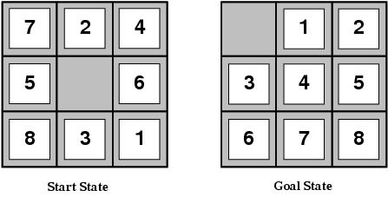
Limitations of uninformed search
8-puzzle
Avg. solution cost is about 22 steps
branching factor ~ 3
Exhaustive search to depth 22:
3.1 x 10¹⁰ states
E.g., d=12, IDS expands 3.6 million states on average
[24 puzzle has 10²⁴ states (much worse)]

Slide 4
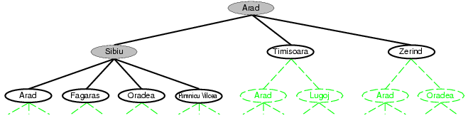
Recall tree search…

Slide 5
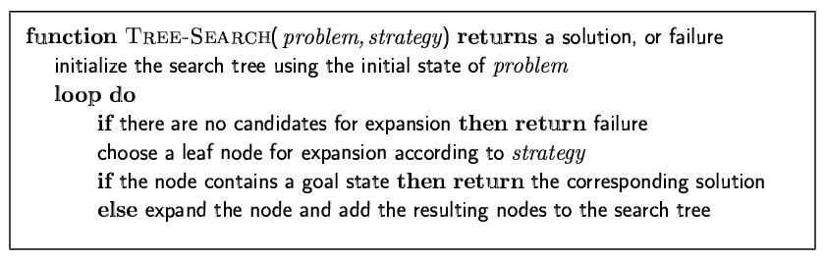
Recall tree search…
This “strategy” is what differentiates different search algorithms

Slide 6
Best-first search
Idea: use an evaluation function f(n) for each node
estimate of "desirability“
Expand most desirable unexpanded node
Implementation:
Order the nodes in fringe by f(n) (by desirability, lowest f(n) first)
Special cases:
uniform cost search (from last lecture): f(n) = g(n) = path to n
greedy best-first search
A* search
Note: evaluation function is an estimate of node quality
=> More accurate name for “best first” search would be “seemingly best-first search”

Slide 7
Heuristic function
Heuristic:
Definition: “using rules of thumb to find answers”
Heuristic function h(n)
Estimate of (optimal) cost from n to goal
h(n) = 0 if n is a goal node
Example: straight line distance from n to Bucharest
Note that this is not the true state-space distance
It is an estimate – actual state-space distance can be higher
Provides problem-specific knowledge to the search algorithm

Slide 8
Heuristic functions for 8-puzzle
8-puzzle
Avg. solution cost is about 22 steps
branching factor ~ 3
Exhaustive search to depth 22:
3.1 x 10¹⁰ states.
A good heuristic function can reduce the search process.
Two commonly used heuristics
h₁ = the number of misplaced tiles
h₁(s)=8
h₂ = the sum of the distances of the tiles from their goal positions (Manhattan distance).
h₂(s)=3+1+2+2+2+3+3+2=18

Slide 9
Greedy best-first search
Special case of best-first search
Uses h(n) = heuristic function as its evaluation function
Expand the node that appears closest to goal

Slide 10
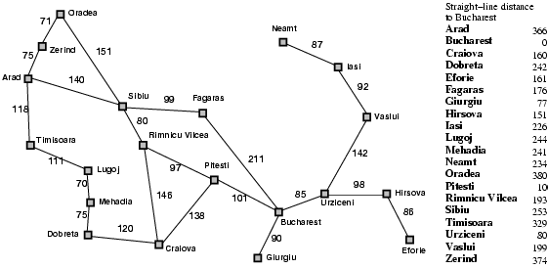
Romania with step costs in km

Slide 11

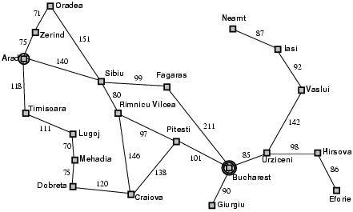
Greedy best-first search example

Slide 12
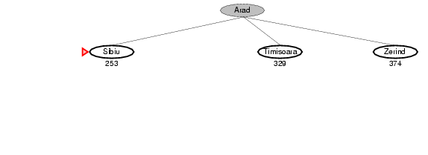
Greedy best-first search example

Slide 13
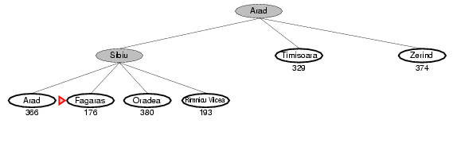
Greedy best-first search example

Slide 14
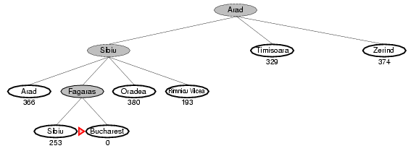
Greedy best-first search example

Slide 15
Optimal Path

Slide 16
Properties of greedy best-first search
Complete?
Not unless it keeps track of all states visited
Otherwise can get stuck in loops (just like DFS)
Optimal?
No – we just saw a counter-example
Time?
O(b^{m}), can generate all nodes at depth m before finding solution
m = maximum depth of search space
Space?
O(b^{m}) – again, worst case, can generate all nodes at depth m before finding solution

Slide 17
A* Search
Expand node based on estimate of total path cost through node
Evaluation function f(n) = g(n) + h(n)
g(n) = cost so far to reach n
h(n) = estimated cost from n to goal
f(n) = estimated total cost of path through n to goal
Efficiency of search will depend on quality of heuristic h(n)

Slide 18

A* search example

Slide 19
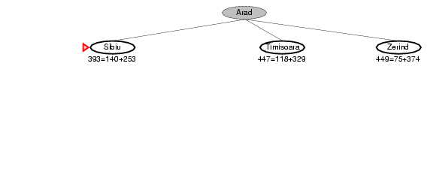
A* search example

Slide 20
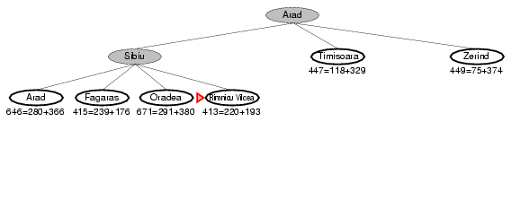
A* search example

Slide 21
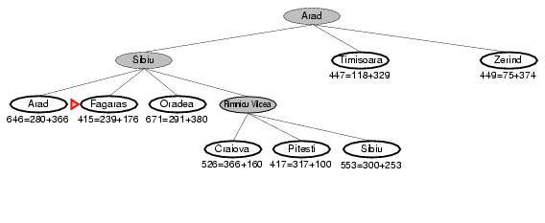
A* search example

Slide 22
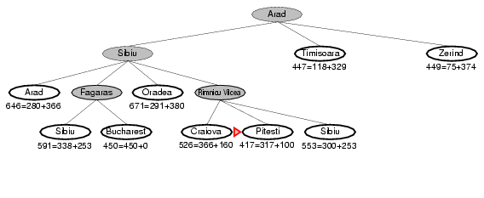
A* search example

Slide 23
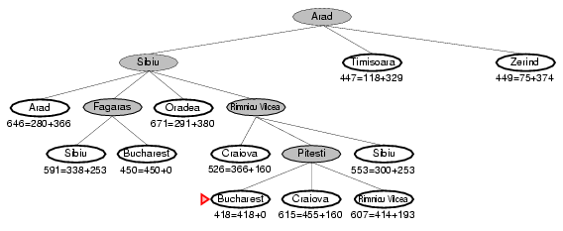
A* search example

Slide 24
Admissible heuristics
A heuristic h(n) is admissible if for every node n,
h(n) ≤ h*(n), where h*(n) is the true cost to reach the goal state from n.
An admissible heuristic never overestimates the cost to reach the goal, i.e., it is optimistic
Example: h_{SLD}(n) is admissible
never overestimates the actual road distance
Theorem:
If h(n) is admissible, A* using TREE-SEARCH is optimal

Slide 25
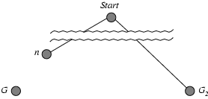
Optimality of A* (proof)
Suppose some suboptimal goal G₂ has been generated and is in the fringe. Let n be an unexpanded node in the fringe such that n is on a shortest path to an optimal goal G.
f(G₂) = g(G₂) since h(G₂) = 0
g(G₂) > g(G) since G₂ is suboptimal
f(G) = g(G) since h(G) = 0
f(G₂) > f(G) from above

Slide 26
Optimality of A* (proof)
Suppose some suboptimal goal G₂ has been generated and is in the fringe. Let n be an unexpanded node in the fringe such that n is on a shortest path to an optimal goal G.
f(G₂) > f(G) from above
h(n) ≤ h*(n) since h is admissible
g(n) + h(n) ≤ g(n) + h*(n)
f(n) ≤ f(G)
Hence f(G₂) > f(n), and A* will never select G₂ for expansion

Slide 27
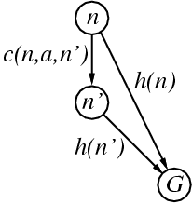
Optimality for graphs?
Admissibility is not sufficient for graph search
In graph search, the optimal path to a repeated state could be discarded if it is not the first one generated
Can fix problem by requiring consistency property for h(n)
A heuristic is consistent if for every successor n' of a node n generated by any action a,
h(n) ≤ c(n,a,n') + h(n')
(aka “monotonic”)
admissible heuristics are generally consistent

Slide 28
A* is optimal with consistent heuristics
If h is consistent, we have
f(n') = g(n') + h(n')
= g(n) + c(n,a,n') + h(n')
≥ g(n) + h(n)
= f(n)
i.e., f(n) is non-decreasing along any path.
Thus, first goal-state selected for expansion must be optimal
Theorem:
If h(n) is consistent, A* using GRAPH-SEARCH is optimal

Slide 29
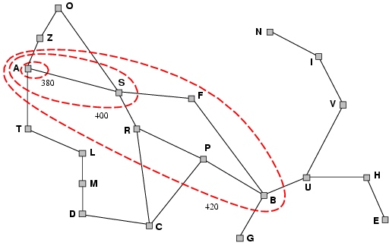
Contours of A* Search
A* expands nodes in order of increasing f value
Gradually adds "f-contours" of nodes
Contour i has all nodes with f=f_{i}, where f_{i} < f_{i+1}

Slide 30
Contours of A* Search
With uniform-cost (h(n) = 0, contours will be circular
With good heuristics, contours will be focused around optimal path
A* will expand all nodes with cost f(n) < C*

Slide 31
Properties of A*
Complete?
Yes (unless there are infinitely many nodes with f ≤ f(G) )
Optimal?
Yes
Also optimally efficient:
No other optimal algorithm will expand fewer nodes, for a given heuristic
Time?
Exponential in worst case
Space?
Exponential in worst case

Slide 32
Comments on A*
A* expands all nodes with f(n) < C*
This can still be exponentially large
Exponential growth will occur unless error in h(n) grows no faster than log(true path cost)
In practice, error is usually proportional to true path cost (not log)
So exponential growth is common

Slide 33
Memory-bounded heuristic search
In practice A* runs out of memory before it runs out of time
How can we solve the memory problem for A* search?
Idea: Try something like depth first search, but let’s not forget everything about the branches we have partially explored.

Slide 34
Recursive Best-First Search (RBFS)
Similar to DFS, but keeps track of the f-value of the best alternative path available from any ancestor of the current node
If current node exceeds f-limit -> backtrack to alternative path
As it backtracks, replace f-value of each node along the path with the best f(n) value of its children
This allows it to return to this subtree, if it turns out to look better than alternatives

Slide 35
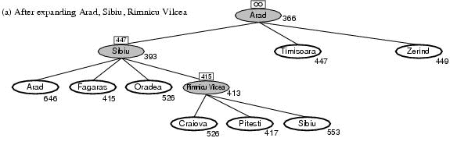
Recursive Best First Search: Example
Path until Rumnicu Vilcea is already expanded
Above node; f-limit for every recursive call is shown on top.
Below node: f(n)
The path is followed until Pitesti which has a f-value worse than the f-limit.

Slide 36
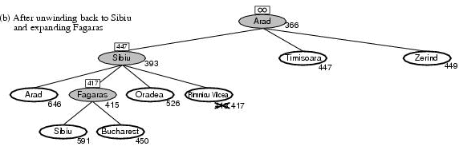
RBFS example
Unwind recursion and store best f-value for current best leaf Pitesti
result, f [best] ← RBFS(problem, best, min(f_limit, alternative))
best is now Fagaras. Call RBFS for new best
best value is now 450

Slide 37
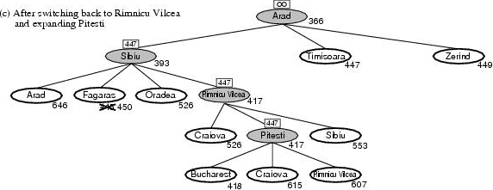
RBFS example
Unwind recursion and store best f-value for current best leaf Fagaras
result, f [best] ← RBFS(problem, best, min(f_limit, alternative))
best is now Rimnicu Viclea (again). Call RBFS for new best
Subtree is again expanded.
Best alternative subtree is now through Timisoara.
Solution is found since because 447 > 418.

Slide 38
RBFS properties
Like A*, optimal if h(n) is admissible
Time complexity difficult to characterize
Depends on accuracy if h(n) and how often best path changes.
Can end up “switching” back and fortyh
Space complexity is O(bd)
Other extreme to A* - uses too little memory.

Slide 39
(Simplified) Memory-bounded A* (SMA*)
This is like A*, but when memory is full we delete the worst node (largest f-value).
Like RBFS, we remember the best descendant in the branch we delete.
If there is a tie (equal f-values) we delete the oldest nodes first.
simplified-MA* finds the optimal reachable solution given the memory constraint.
Time can still be exponential.

Slide 40
Heuristic functions
8-puzzle
Avg. solution cost is about 22 steps
branching factor ~ 3
Exhaustive search to depth 22:
3.1 x 10¹⁰ states.
A good heuristic function can reduce the search process.
Two commonly used heuristics
h₁ = the number of misplaced tiles
h₁(s)=8
h₂ = the sum of the distances of the tiles from their goal positions (manhattan distance).
h₂(s)=3+1+2+2+2+3+3+2=18

Slide 41
Notion of dominance
If h₂(n) ≥ h₁(n) for all n (both admissible) then h₂ dominates h₁
h₂ is better for search
Typical search costs (average number of nodes expanded) for 8-puzzle problem
d=12 IDS = 3,644,035 nodes A*(h₁) = 227 nodes A*(h₂) = 73 nodes
d=24 IDS = too many nodes A*(h₁) = 39,135 nodes A*(h₂) = 1,641 nodes

Slide 42
Effective branching factor
Effective branching factor b*
Is the branching factor that a uniform tree of depth d would have in order to contain N+1 nodes.
Measure is fairly constant for sufficiently hard problems.
Can thus provide a good guide to the heuristic’s overall usefulness.

Slide 43
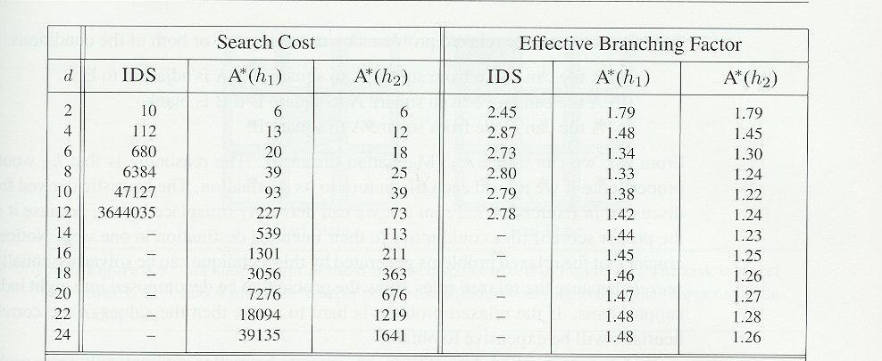
Effectiveness of different heuristics
Results averaged over random instances of the 8-puzzle

Slide 44
Inventing heuristics via “relaxed problems”
A problem with fewer restrictions on the actions is called a relaxed problem
The cost of an optimal solution to a relaxed problem is an admissible heuristic for the original problem
If the rules of the 8-puzzle are relaxed so that a tile can move anywhere, then h₁(n) gives the shortest solution
If the rules are relaxed so that a tile can move to any adjacent square, then h₂(n) gives the shortest solution
Can be a useful way to generate heuristics
E.g., ABSOLVER (Prieditis, 1993) discovered the first useful heuristic for the Rubik’s cube puzzle

Slide 45
More on heuristics
h(n) = max{ h1(n), h2(n),……hk(n) }
Assume all h functions are admissible
Always choose the least optimistic heuristic (most accurate) at each node
Could also learn a convex combination of features
Weighted sum of h(n)’s, where weights sum to 1
Weights learned via repeated puzzle-solving
Could try to learn a heuristic function based on “features”
E.g., x1(n) = number of misplaced tiles
E.g., x2(n) = number of goal-adjacent-pairs that are currently adjacent
h(n) = w₁ x1(n) + w₂ x2(n)
Weights could be learned again via repeated puzzle-solving
Try to identify which features are predictive of path cost

Slide 46
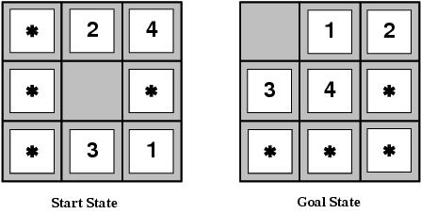
Pattern databases
Admissible heuristics can also be derived from the solution cost of a subproblem of a given problem.
This cost is a lower bound on the cost of the real problem.
Pattern databases store the exact solution to for every possible subproblem instance.
The complete heuristic is constructed using the patterns in the DB

Slide 47
Summary
Uninformed search methods have their limits
Informed (or heuristic) search uses problem-specific heuristics to improve efficiency
Best-first
A*
RBFS
SMA*
Techniques for generating heuristics
Can provide significant speed-ups in practice
e.g., on 8-puzzle
But can still have worst-case exponential time complexity
Next lecture: local search techniques
Hill-climbing, genetic algorithms, simulated annealing, etc

